Slide 1
AWS DataHub
<Partner Name>
<Date>

Slide 2
Agenda
Intros (10 mins)
Datahub positioning (15 mins)
Demo! (30 mins)
Next steps / opportunities (30 mins)

Slide 3
Data Literacy for Enterprises: Status Quo for the past 20 years!
Data access is hard
Data security, Data Discovery, Data governance, Lineage … you know the story
A data engineering team does everything and becomes the bottleneck
Data sharing comes with prohibitive costs (data movements and infrastructure setup)
Finding and touching data is a nightmare
Every singled data driven applications spend an entry ticket
With every new data idea, customers need to go through project/infra/security setup every time
Any cross system analytics project will take months to build, let alone AI/ML applications and Data APIs applications
What if we can escape the forces that keep data locked within the bottleneck of data experts and databases silos across multiple Business Units?
DataHub is the answer: Any line of business within an organization can create their own isolated data lake, produce, consume and share data within and across business units, worldwide. By simplifying and harmonizing data discovery, data access management while letting more builders use AWS vast portfolio of data, analytics and AI/ML services, Datahub helps more data teams discover relevant data and monetize it.

Slide 4
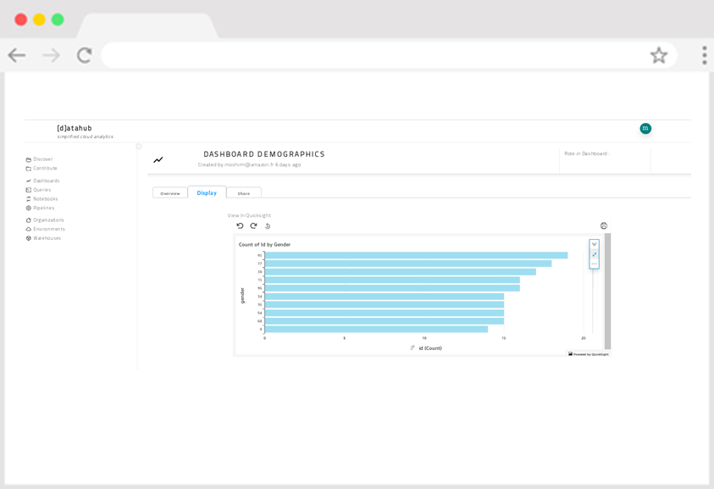
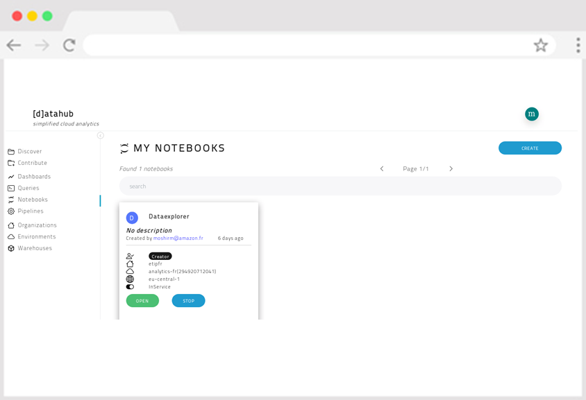
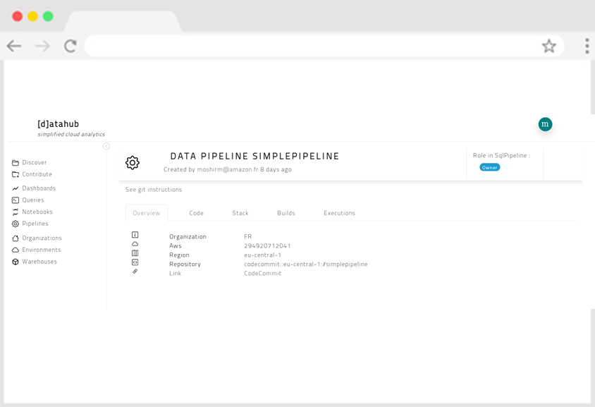


Problems Datahub solves Accelerate delivery of data-driven applications for all data citizens across different BUs/departments/teams
Integrated Dashboards
Integrated Notebooks
Integrated Data & ML Pipelines
Business Analysts
Data Scientists
Data Engineers

Slide 5
Problems DataHub Solves > Do It Yourself
Q1
Q2
Q3
Q4
…
~ 14-18 months project
~2.4M€ investment
Scarce Cloud Resources
DIY
unpredictable
Expertise
Bottleneck
DataHub
8 weeks
Automation
predictable
Scale

Slide 6
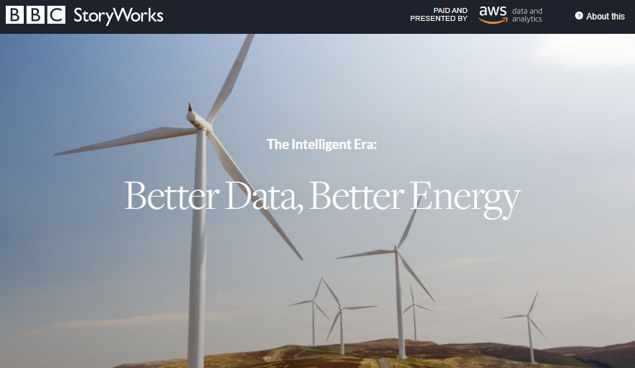
Reference - Engie
http://www.bbc.com/storyworks/specials/the-intelligent-era/better-data-better-energy/
Engie link
Customer Engineering (Thomas Furthman) to develop additional features for “After-Sales” support
Partner enablement

Slide 7

Arriva Delivers Modern Data Platform with AWS DataHub & Professional Services
Challenges
Solution
Results
Arriva was looking to improve the way they collect, manage, analyse, and visualise their business data. Their current data platform has grown over time and created architectural challenges that have started to affect business processes.
To resolve these issues Arriva is looking to build a green field enterprise data platform that will be an organization-wide central data repository where raw data can be ingested, transformed, shared, and visualized securely.
Professional Services implemented AWS DataHub to provide a modern, enterprise-scale data management platform that can store (Amazon S3), process (AWS Step Functions and AWS Glue), share (to Arriva IDP groups), and visualize data (Amazon QuickSight).
Creation of granular roles to control access to data.
Prove DataHub capability by implementing use case and train Arriva and its partners on the DataHub platform.
Significant accelerator advantage, allowing the build of Arriva’s new data platform at significantly reduced timescales.
Demonstrated strength of AWS DataHub capabilities, a framework for easily creating pipelines that ingest, transform, discover, and access curated data.
Ongoing engagement and support alongside the proposed ecosystem for ongoing product development.
Customer:
Arriva PLC
Industry:
Transport
Country:
United Kingdom
Employees:
~61,845
Website:
https://www.arriva.co.uk/
Customer Profile:
Arriva is a leading provider of passenger transport in Europe, employing around 46,000 people and, in 2020, delivered around 1.2 billion passenger journeys across 14 European countries. It is part of Deutsche Bahn (DB), one of the world’s leading passenger and logistics companies, and is responsible for DB’s regional passenger transport services outside Germany.
Arriva connects communities throughout 14 European markets: the Czech Republic, Croatia, Denmark, Hungary, Italy, the Netherlands, Poland, Portugal, Serbia, Slovakia, Slovenia, Spain, Sweden, and the UK.
“From the initial engagement to validate our proposed architecture, through to set up of the DataHub and build out of the initial use cases, the Professional Services team have played a key role in the construction of Arriva’s new data capability.”
-Simon Hick, Interim Solution Delivery Director

Slide 8



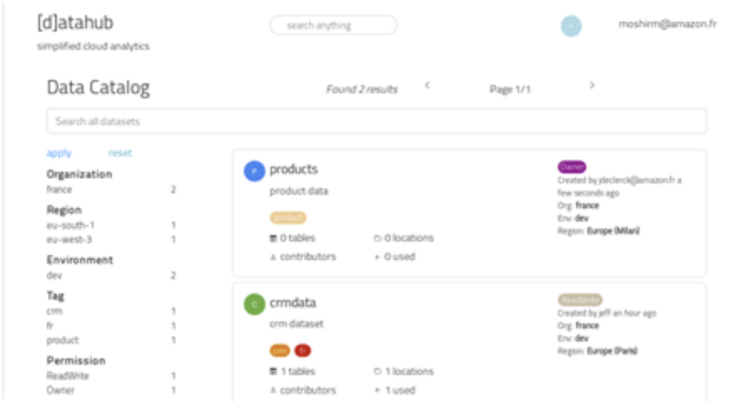







DataHub solves enterprise data problems through Distributed Data Lakes, Centralized Catalog, and Development Accelerators
Collect any data
Govern Data Access
Build Data Driven Application
Centralized Catalog
Data owner
delegate
Data Steward
Data Consumer
Rev. Analytics
request
Amazon Quick Sight
Amazon Redshift
grant
Connect
Data Source
Data Source
Data Source
Industrialize
SQL Based
Datahub Universal
Data Pipeline
AWS Services
DMS
Data Source
Data Source
Data Source
Amazon Athena
Amazon S3
Amazon Sage Maker
AWS Glue
(pyspark)
ETL
Baggage Predcitions
Kinesis
DATA LAKE A
DATA LAKE B
DATALAKE C
DATALAKE D
AWS Lambda

Slide 9
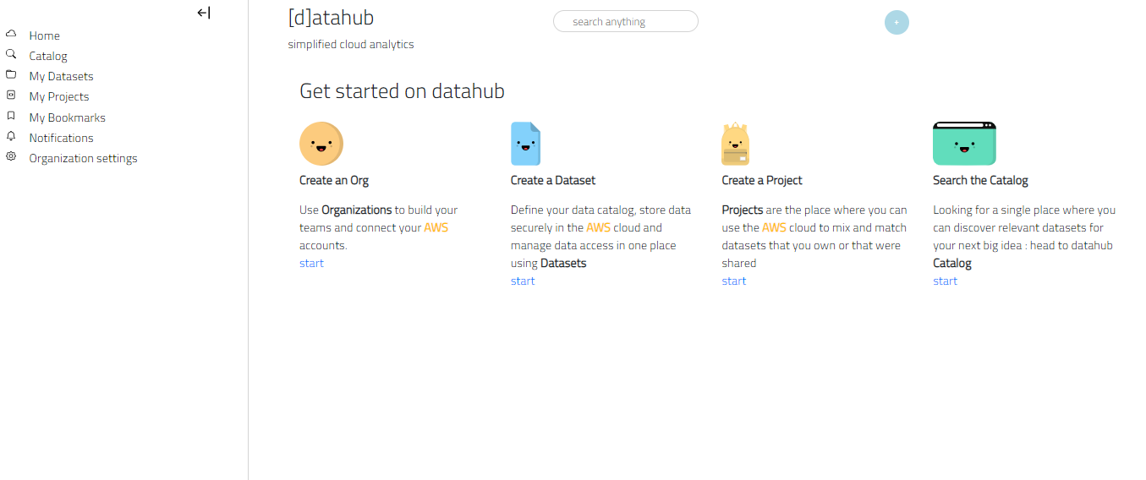
Demo !
For Data Stewards
For Data Engineers
For Data Consumers
One enterprise data catalog
Integrated Data Governance
Share all data across lines of business
Integrated Data Processing
Integrated ML Pipeline
Integrated BI
Request Access to All Data

Slide 10
Datahub – trigger phrases
“We have lots of different data initiatives / data lake projects running in different places”
“I’d like an enterprise-wide, searchable business data catalog” “I need an easy to use and scalable way to manage access to data” “I’ve heard about data mesh / federated data lake architectures” “My Data Engineers are spending a lot of time writing Python / Scala” “How can we make data governance actionable”

Slide 11

DataHub architecture follows classical 3-Tier applications implemented using mostly AWS Serverless services
Presentation
Web Server
Web App
Database / AWS Services
A presentation layer hosted in Cloud Front
Application server layer consists of web server layer (API Gateway) and Lambdas
Persistent layers on Aurora Serverless Postgress for Catalog and AWS Services
Message Bus
Amazon Kinesis as the message bus
Background Worker

Slide 12
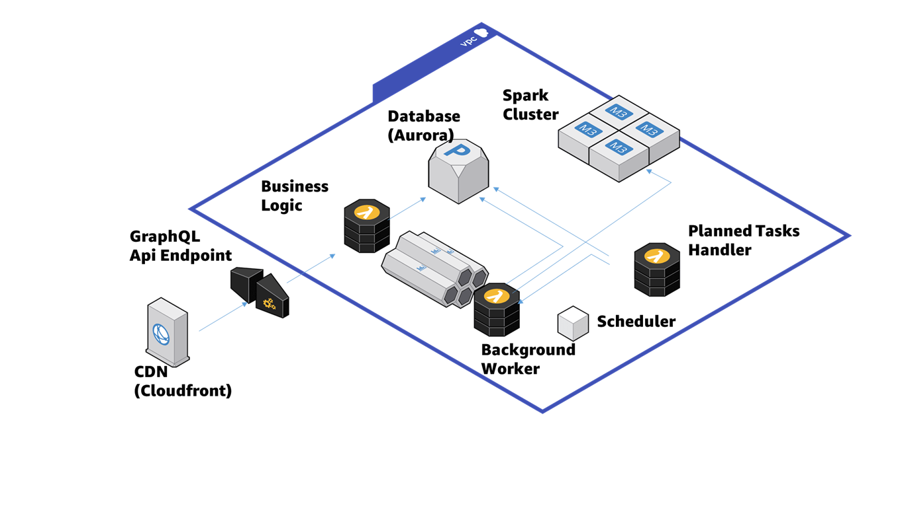
DataHub is a thin layer implemented using Serverless Architecture overlaying several services of AWS
DataHub solution relies on AWS Services (Lake Formation, Cloud Formation, Athena, Aurora Serverless, Lambda,API Gateway, Code Pipeline, Kinesis, EMR, Glue, Sage Maker, S3, Cloud Front, IAM, Cognito, CloudWatch event, VPC)
In term of codes, the solution consists of:
1 API Gateway
3 Lambda
1 Web App hosted in Cloud Front
All resources, except Cloud Front and API Gateway, are run in AWS Virtual Private Cloud (VPC)

Slide 13

Python is the language used in Lambdas and Javascript (React.js) is used for the front end
Python 3.7
Business Logic Lambda
Implement business logic of DataHub
Communicate with Worker Lambda through Kinesis message bus
React hooks (useState, useEffect) for state management
Apollo Client to interact with DataHub API
Bundled using create-react-app utility
Saved to S3 and distributed by Cloud Front
AWS Lambda
Worker Lambda
Execute AWS API
AWS Lambda
Scheduled Lambda
Execute scheduled tasks
AWS Lambda

Slide 14
Interaction with DataHub can be done through DataHub API and through User Interface
UI
API
GraphQL API is used
JWT Tokens and API Key/Secret pairs for authentication
API Gateway benefits

Slide 15


Worker Lambda in central DataHub assumes a specific role to interact with AWS services of other accounts
Account with which DataHub interacts
Account where DataHub is deployed
DatahubPivotRole
assumes
Amazon Athena
Amazon S3
Business Logic
Worker Lambda
Lake Formation
AWS Glue

Slide 16
DataHub creates necessary resources for DataSet to make the DataSet shareable
DataSet consists of
An Amazon S3 Bucket where data from the dataset are being stored
An Amazon S3 Bucket Policy controlling
Access policy to the S3 Bucket
Automated encryption of the data, using Amazon S3 Server Side Encryption
A Lakeformation/Glue Database storing structured data metadata
An IAM Role with permissions over the underlying data of the Dataset, Bucket configuration, Dataset metadata through Lakeformation. The IAM Role can be used to interact with AWS through console or API.
An IAM User for the Dataset with only permissions on the S3 Data, used to generate a permanent IAM Credentials, that Dataset contributors will use to configure third-party solutions to send (or retrieve data) that are sitting in their S3 Bucket

Slide 17
DataHub creates Project resources that allow working on the DataSets using DataHub accelerators or EC2-based app
A Bucket to store Project related data, like code, documentation, anything that is not meant to be discovered in the dataset catalog, and that is used by the project
A Glue Database specific to the Project, and where Datahub will copy Tables from of all Datasets Tables available to the Project
An IAM Role, defining fine grained permissions on the Project Dataset Tables and storage locations

Slide 18
Project Accelerators contain a way to define pipelines without defining Step Functions
Project accelerators contain universal data pipeline, that can orchestrate:
Lambda Functions
Glue (Pyspark)
Sage Maker
Behind the scene, project accelerators integrate with:
Step Function. Universal Data Pipeline can be seen as Step Functions generator. A user can just define the steps inside accelerators.
Code Commit. To version the codes.
Code Pipeline. To run the pipeline whenever a new code is pushed.

